Slide 1
Assignment 4 of Team 8
-fix the previous assignments
*Updated on Feb. 24th (added packages, fixed use specification)
*Updated on Feb. 28th (fixed state diagram)
Weizhao Li & Peiyao Teng

Slide 2
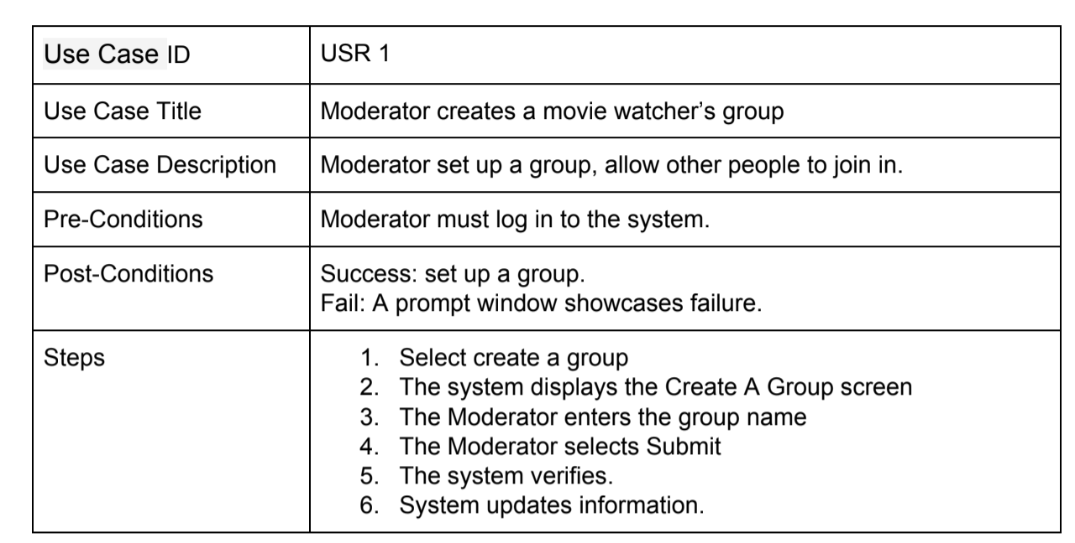
Use case specification
We fixed the use case specifications. In this graph, we showcase you an example of our use case specifications, to see more, click on this URL:
https://drive.google.com/file/d/1N1C8OaQiBY00mPpUkeL0Y9Y3pv2T8-fU/view?usp=sharing

Slide 3
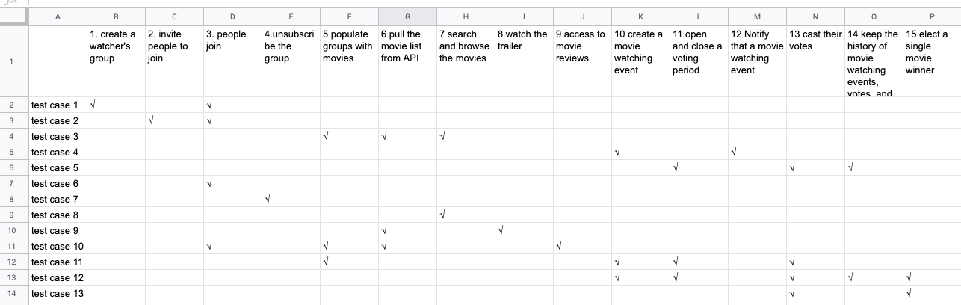
Bi-direction traceability matrix

Slide 4
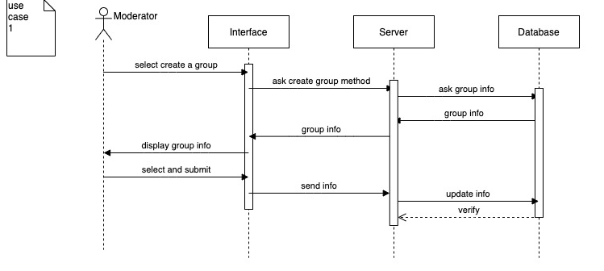
Sequence diagram
Here is one of the example of our sequence diagrams, to view more, click on this URL:
https://drive.google.com/open?id=1n753-DjR_PE4-Riyu_T10z-AIZfixYln

Slide 5
Class diagram
Here are the main classes of our Movie Watcher System.
MovieWatcherSystem:
The center part of the whole system. Enables to record the event, record the group with the winner movie, notify people of a watch event. It has attributes like systemID, lisfOfEvents, listOfGroup, group with winner movie.
Event:
A MovieWatcherSystem can have several events. A specific event will have an eventID, a createTime. The moderator can add the MovieWatchInfo and add the vote.
Group:
A MovieWatcherSystem can have several groups. Each group will have a name, an ID, a member list, a moderator ID.
MovieWatchInfo:
An event can have a MovieWatchInfo class, which means the info of the event. A MovieWatchInfo will have attributes like movieInfo, address, groupID. It can set the group.

Slide 6
Class diagram
Vote:
An event can have a Vote class. The vote class will have attributes like movieList, beginTime and expireTime, groupID, records of movie with its voted counts, and the winner movie. It will updateRecord, get the count, get the winner.
Person:
We have two types of person in this system, Moderator and Participants. The person has attributes like name, ID, eMail, age, gender.
Moderator:
The moderator will invite people to join a group, search the movie, create a group, populate the movies, create a movie watching event, create and end the vote, cast the vote, watch the trailer, see the reviews.
Participant:
The participant will join the group, search the movies, unsubscribe the group, cast the vote, see the reviews, watch the trailers.
Movie:
The movie has attributes like name, id, rating, year, type. It will get the reviews, get the trailers. The moderator and the participant can process the movie like calling getReviews, getTrailers.

Slide 7
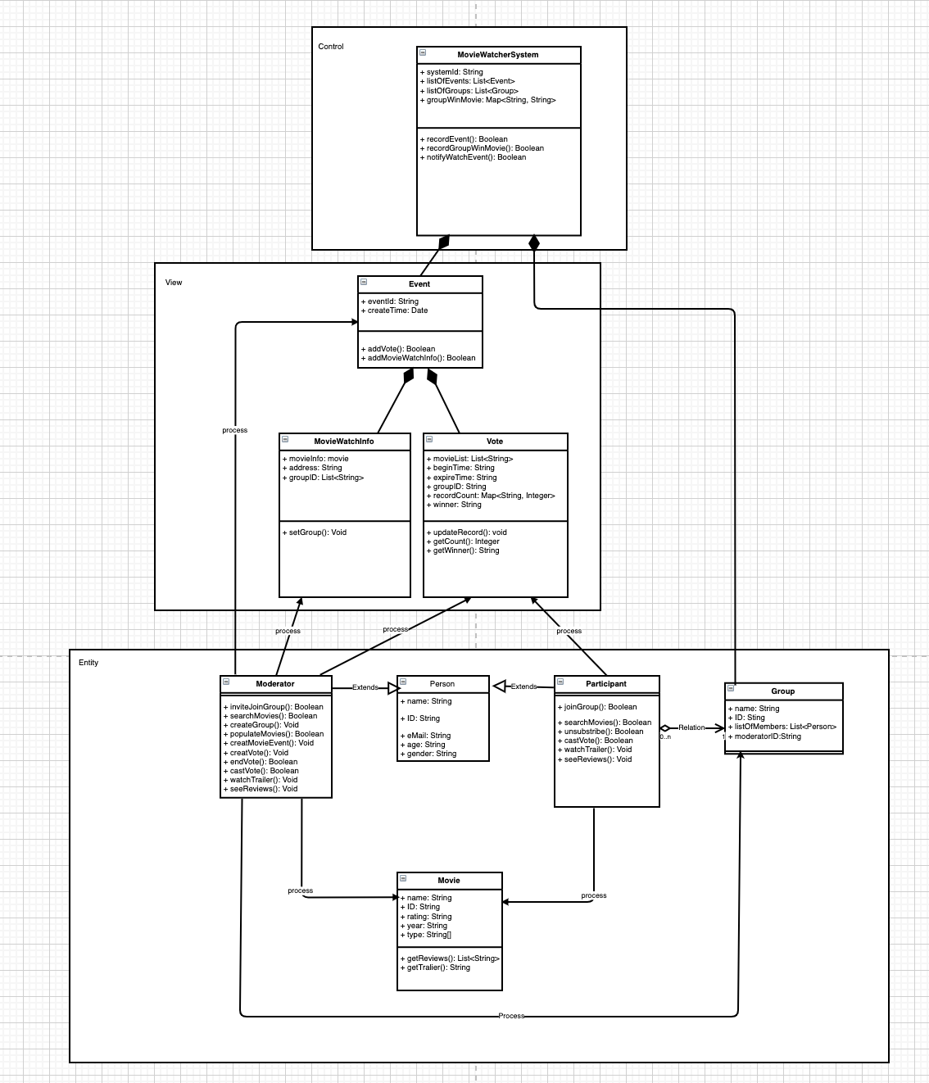
Class diagram
We added 3 different UML packages to organize the classes.
To view it more clearly, click this URL:
https://drive.google.com/file/d/1_RGyMUHCvq4PdBAskFoAWWv4A7xOYMCD/view?usp=sharing

Slide 8
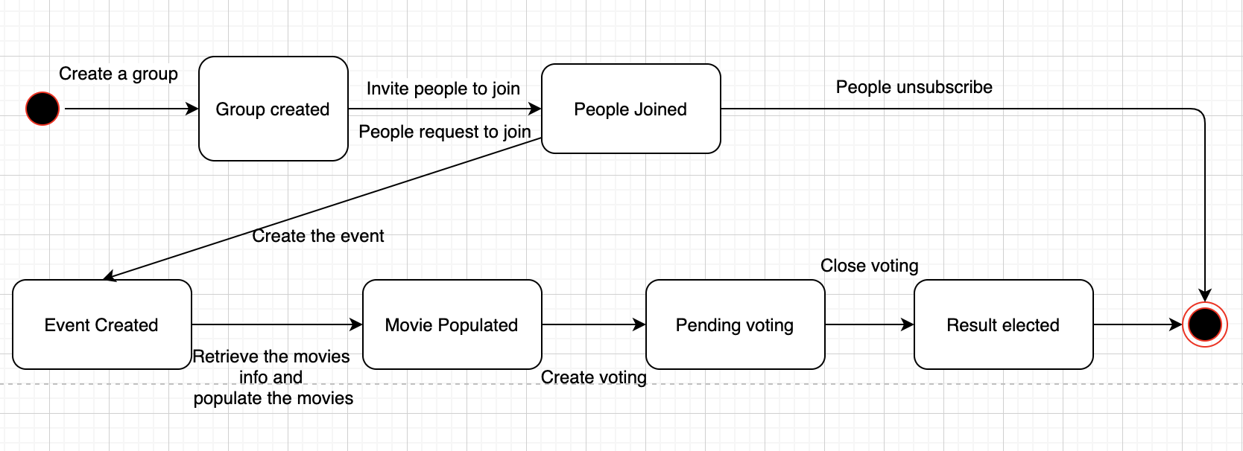
State diagram

